Slide 1
SCALABLE LOGGING THROUGH EMERGING MEW HARDWARE
PRESENTED BY HUAN ZHOU

Slide 2
OUTLINE
Introduction
Logging Overview
Bottlenecks
Scalable Database Logging for Multicores
Architecture
Design
NVRAM-aware Logging in Transaction Systems
NVM
Design
Conclusion

Slide 3


LOGGING OVERVIEW
A log is a sequential file that stores information about transactions.
Example of transaction:
– T1: Transfer $50 from account A to account B
T1:
A=A-50
B=B+50
A= 50-50
B=100+50
DRAM
Transaction Manager
Excessive disk I/O !!
lsn=1, T1, A=0
A 50
C 500
B 100
D 600
HDD
A 100
C 500
lsn=2, T1, B=150
Log Records
Data Block
lsn=3, T1, commit
Commit Log
Log File

Slide 4
LOGGING OVERVIEW
A log is a sequential file that stores information about transactions.
Example of transaction:
– T1: Transfer $50 from account A to account B
T1:
A=A-50
B=B+50
A= 50-50
B=100+50
DRAM
1 | 2 | 3
Transaction Manager
Log Buffer
Group Commit
lsn=1, T1, A=0
A 50
C 500
B 100
D 600
HDD
A 100
C 500
lsn=2, T1, B=150
Log Records
Data Block
lsn=3, T1, commit
Commit Log
Log File

Slide 5
LOGGING PROCEDURE
Log record generation;
LSN generation and log buffer acquire;
Log record insertion;
Log buffer release;
log record persistent.
DONE
T1
Commit
lsn=1, T1, A=0
lsn=2, T1, B=150
DONE
T2
Commit
lsn=3, T1, commit
Log File
DRAM
HDD

Slide 6
LOGGING BOTTLENECKS
DONE
T1
Commit
lsn=1, T1, A=0
2
lsn=2, T1, B=150
DONE
T2
Commit
lsn=3, T1, commit
1
Log File
HDD
1. Multicore Scalability
more transactions faces the serialization bottleneck when storing concurrently generated logs
2. Synchronous I/O Delay:
flushing a log buffer to stable storage by the WAL protocol incurs synchronous I/O delay.

Slide 7
SCALABLE LOGGING FOR MULTICORES

Slide 8
OVERALL ARICHITECTURE
Multicore Scalability: LSN allocation is done by using the atomic fetch-add instruction.
Synchronous I/O delay: using latency-hiding techniques
T1
T2
Tn
void eleda_invoke_callback
DB threads
long eleda_reserve_lsn
void eleda_write_log
ELEDA APIs
DRAM
Storage Durable LSN (SDL)
Inserting
Sequentially Buffered LSN (SBL)
Log Sequence Number (LSN)
How to track LSN holes fast and advance SBL ?
Storage durable log
Flushing logs
ELEDA flusher thread
HDD
Fully buffered log
Log File
Partially buffered log
Unused log buffer

Slide 9
ADVANCING SBL
SBL-hopping
advancing SBL by hopping the hopping distance, provided that logs in a given LSN range are all sequentially buffered.
SBL-crawling
advancing SBL by chasing LSN holes thoroughly, once the presence of LSN holes.
i * 2^{H}
(i+1) * 2^{H}
(i+2) * 2^{H}
(i+3) * 2^{H}
2^{H}
2^{H}
2^{H}
2^{H} = hopping distance
A dedicated ELEDA worker thread is used to advance SBL

Slide 10
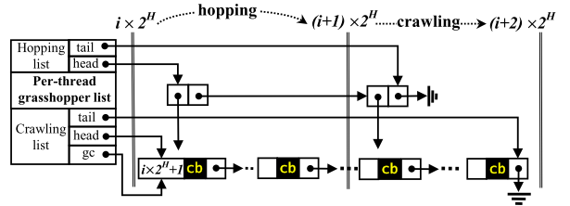
DATA STRUCTURES & SBL-HOPPING
Grasshopper list
managing LSNs that have been buffered but not confirmed to be durable yet
a grasshopper list is created for each database thread
Hopping index
bookkeeping the cumulative byte count of buffered logs for one hopping distance
Hopping index
Copied byte
i * 2^{H}
2^{H}
(i+1) * 2^{H}
<2^{H}
...
(i+2) * 2^{H}
start_lsn
end_lsn
callback
pending LSN node

Slide 11
DATA STRUCTURES & SBL-CRAWLING
LSN-heap
built from the head nodes of per-thread crawling lists
LSN-heap is exclusively managed by the ELEDA worker thread
the top of the LSN-heap is guaranteed to be the smallest pending LSN
head node
3
cb
10
cb
29
cb
3
1
1
cb
11
cb
28
cb
2
2
cb
15
cb
cb
27
...
LSN-heap
per-thread crawling lists

Slide 12
EVALUATION SETUP
Compare logging on Multicore server
36 Hardware Threads & 2 NVMe SSDs
I/O unit for flushing logs is set to 64K
Hopping distance is set to 4M
Use three variants and two database
Traditional logging on NVMe SSDs(NVMe)
Traditional logging on the tmpfs in-memory file system(tmpfs)
ELEDA-based logging on NVMe SSDs(ELEDA)
WiredTiger & Shore-MT
Benchmark
YCSB (50% Reads and 50% Writes)

Slide 13
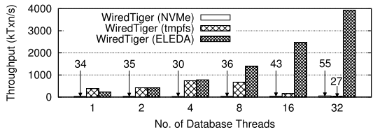
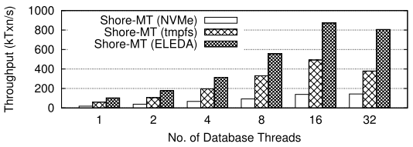
THROUGHPUT
71x
(a) WiredTiger
6.3x
The drop in Shore-MT(ELEDA) is due to the assignment of TID
The drop in WiredTiger(tmpfs) is because of the non-scalable lock
(b) Shore-MT
Notes:
ELEDA 3.9百万tps， tmpfs下降是因为non-scalable lock
ELEDA在16个线程之后下降，是因为事务管理器分配事务ID的冲突导致的

Slide 14
NVRAM-AWARE LOGGING IN TRANSACTION SYSTEMS

Slide 15
LOGGING BOTTLENECKS
DONE
T1
Commit
lsn=1, T1, A=0
2
lsn=2, T1, B=150
DONE
T2
Commit
lsn=3, T1, commit
1
Log File
HDD
1. Multicore Scalability
more transactions faces the serialization bottleneck when storing concurrently generated logs
2. Synchronous I/O Delay:
flushing a log buffer to stable storage by the WAL protocol incurs synchronous I/O delay.

Slide 16


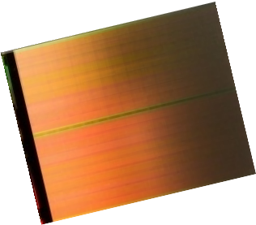
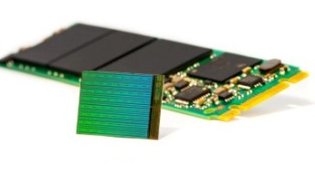



NON-VOLATILE MEMORY(NVM)
DRAM
NVM
SSD
Like DRAM, low latency loads and stores
Like SSD, persistent writes and high density

Slide 17
HOW TO USE NVM IN DBMS
TRANSACTION
TRANSACTION
LOG BUFFER
(DRAM)
PAGE CACHE
(DRAM)
LOG BUFFER
(DRAM)
PAGE CACHE
(DRAM)
LOG AND DB TABLES
(HDD/SDD)
LOG AND DB TABLES
(NVRAM)
Traditional Design
All-in-NVRAM
Which one we should take?
TRANSACTION
LOG BUFFER
(NVRAM)
PAGE CACHE
(DRAM)
DB TABLES
(HDD/SSD)
NVLogging

Slide 18



USING NVM IN COST-EFFECTIVE WAY
all-in-HDD
all-in-SSD
all-in-NVRAM
db-in-SSD, log-in-NVRAM
db-in-HDD, log-in-NVRAM
Normalized TPS (all-in-HDD as the baseline)
75
70
$
65
18%
60
$
$
55
26%
50
$
45
$
$
40
51X
35
30
$
25
20
15
10
5
0
TPCC
TATP
TPCB
Bridging the performance gap with less cost

Slide 19



BOTTLENCK SHIFTED TO SOFTWARE
Misc
DB Operations
Lock Manager
Log Contention
Log Operations
100%
80%
Percentage
60%
40%
20%
0%
log-in-HDD, db-in-NVRAM
log-in-SSD, db-in-NVRAM
log-in-NVRAM, db-in-HDD
log-in-NVRAM, db-in-SSD
all-in-NVRAM
Software-induced overhead becomes the new bottleneck!

Slide 20


DECENTRALIZED LOGGING
leveraging per-transaction logging for decentralized operation
T1
LSN=0
LSN=2
LSN=3
63
0
Global LSN
LSN=1
LSN=4
LSN (64 bits)
DRAM
T2
Flush-on-insert
&
Flush-on-commit
Log_head
States
Pointer
Log Entry
Log Entry Index
NVM
0: DRAM
1: NVM
LogRec Object
Log_tail

Slide 21
EVALUATION SETUP
Compare logging on Intel Persistent Memory Emulator Platform
16 Hardware Threads
64 GB DRAM + 256 GB NVM
Use three variants and one database
Traditional logging on NVM
Distributed logging
NV-logging
Shore-MT
Benchmark
TPCB

Slide 22




THROUGHPUT
db-in-HDD, log-in-NVRAM
db-in-SSD, log-in-NVRAM
Distributed Logging
NVLogging
70
60
50
40
30
20
10
0
Throughput (K TPS)
DRAM 300 400 500
NVRAM Latency (nanoseconds)
NVLogging improves TPS by 2.3x,
compared to the baseline (db-in-SSD, log-in-NVRAM)

Slide 23
CONCLUSION
Bottlenecks of AREIS-Logging
Multicore Scalability
Synchronous I/O Delay
ELEDA eliminates the bottlenecks through
Scalable LSN acquisition and Concurrent data structures
Latency-hiding techniques
NVM-Logging improves the throughput by
Exploiting NVM’s non-volatility and low latency
designing per-transaction logging

Slide 24
Thanks!
Q
A

